Slide 1
SCPipe

Slide 2
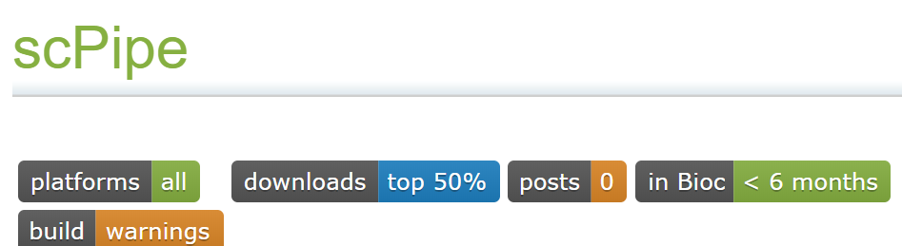
Tutorial
https://bioconductor.org/packages/release/bioc/vignettes/scPipe/inst/doc/scPipe_tutorial.R
Design for complete pipeline
GeneExpression, GenomeAnnotation, Preprocessing, QualityControl, SequenceMatching, Sequencing, Visualization
Tian L and Su S (2017). scPipe: pipeline for single cell RNA-seq data analysis. R package version 1.0.6, https://github.com/LuyiTian/scPipe.

Slide 3
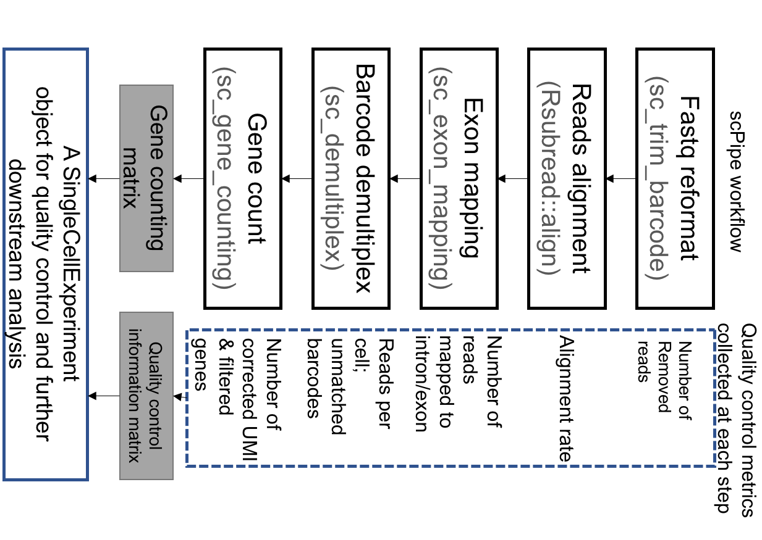

Slide 4
Single Cell Portal

Slide 5
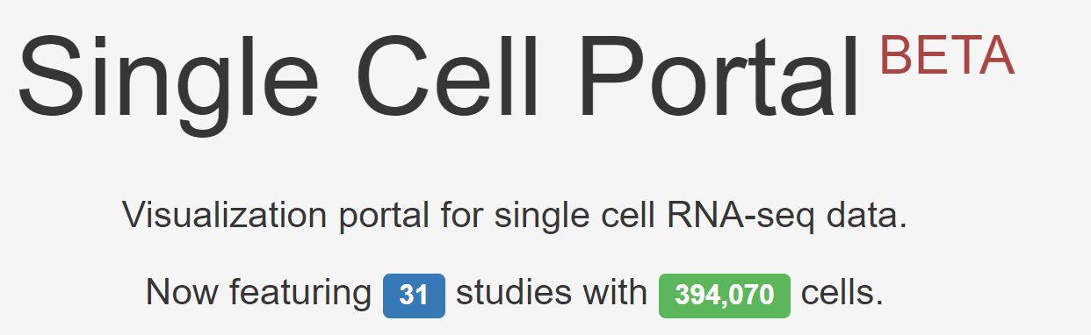
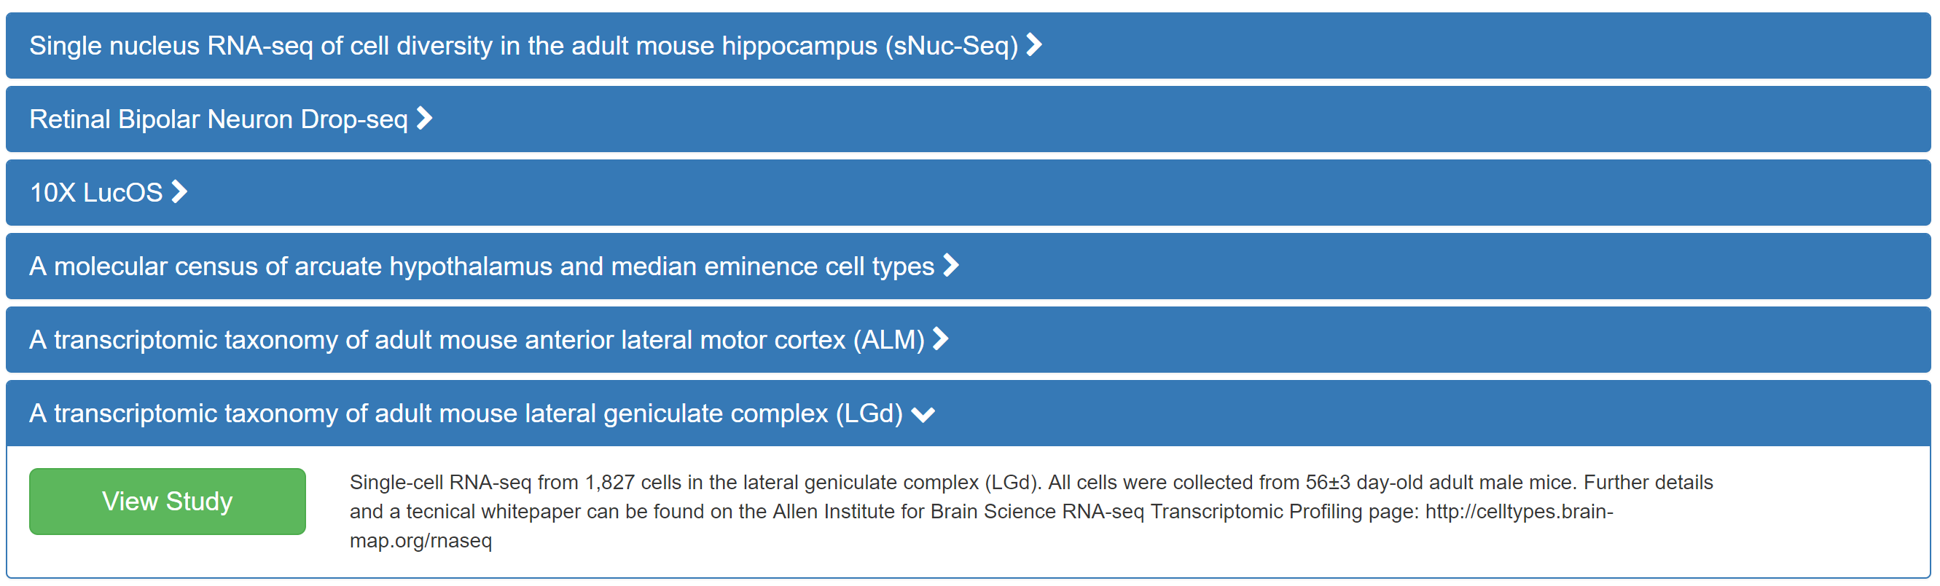

Slide 6
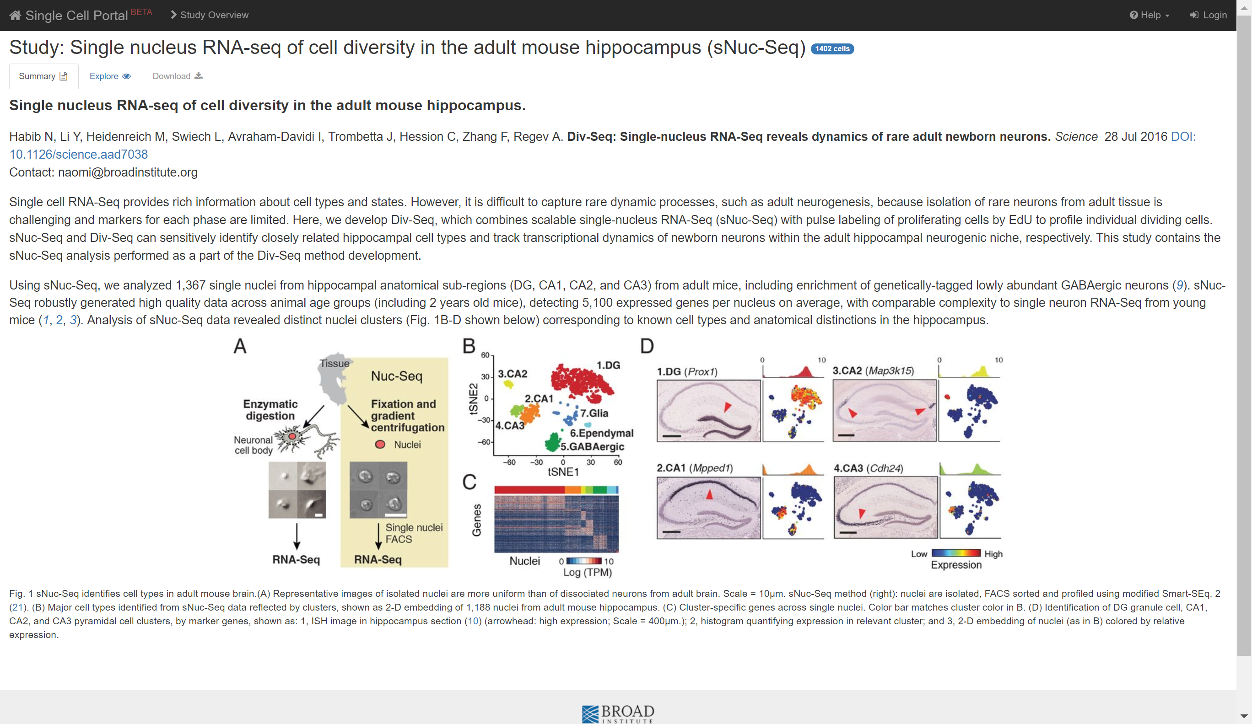

Slide 7
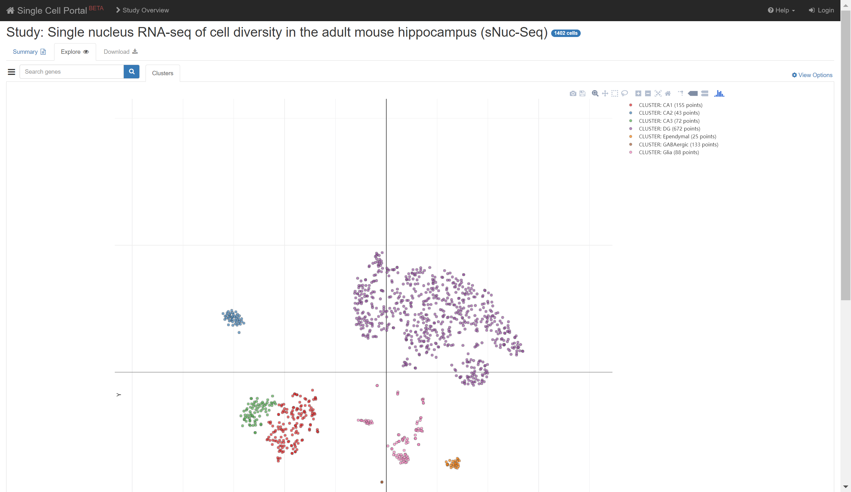

Slide 8
scRNA-tools

Slide 9
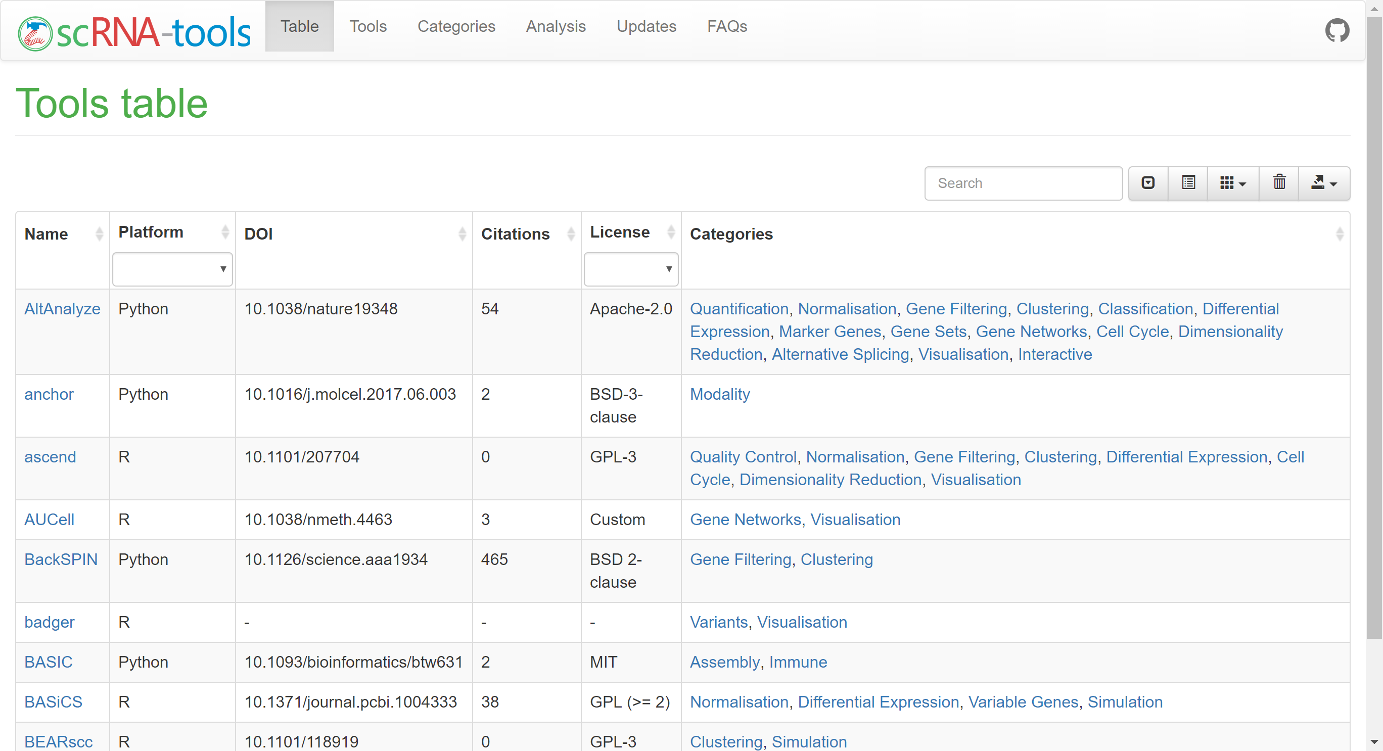

Slide 10
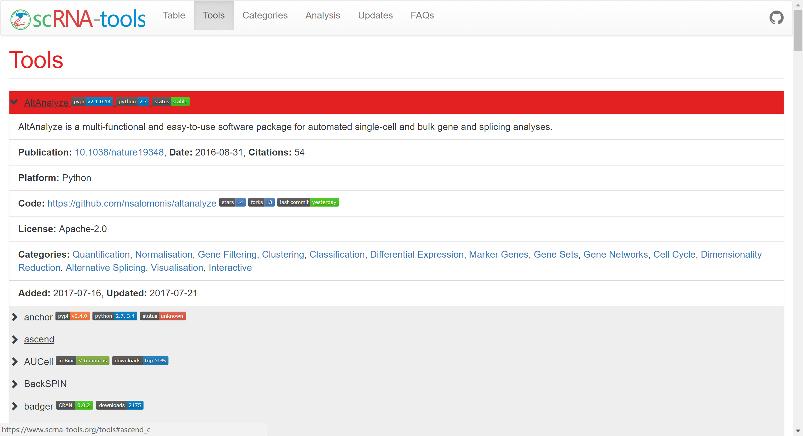

Slide 11
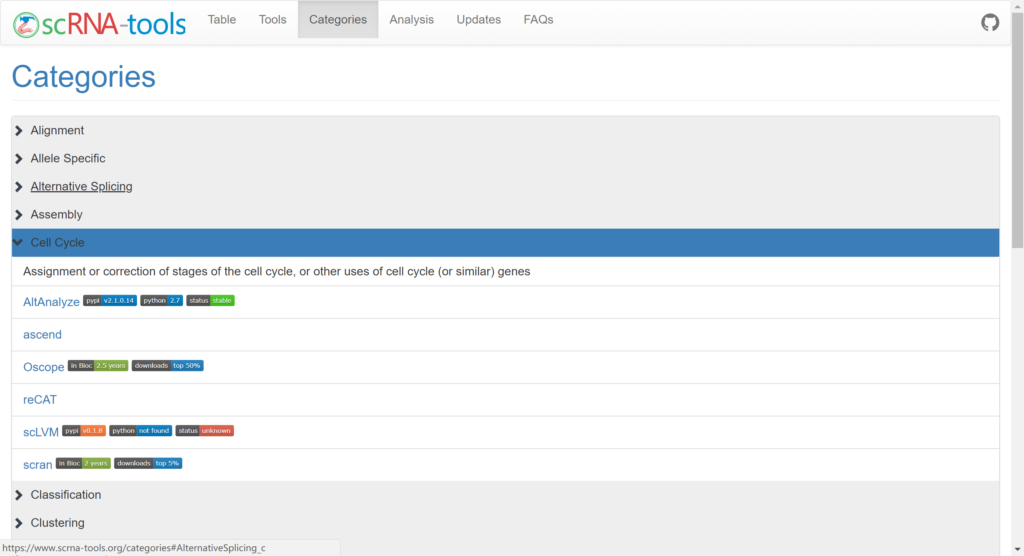

Slide 12
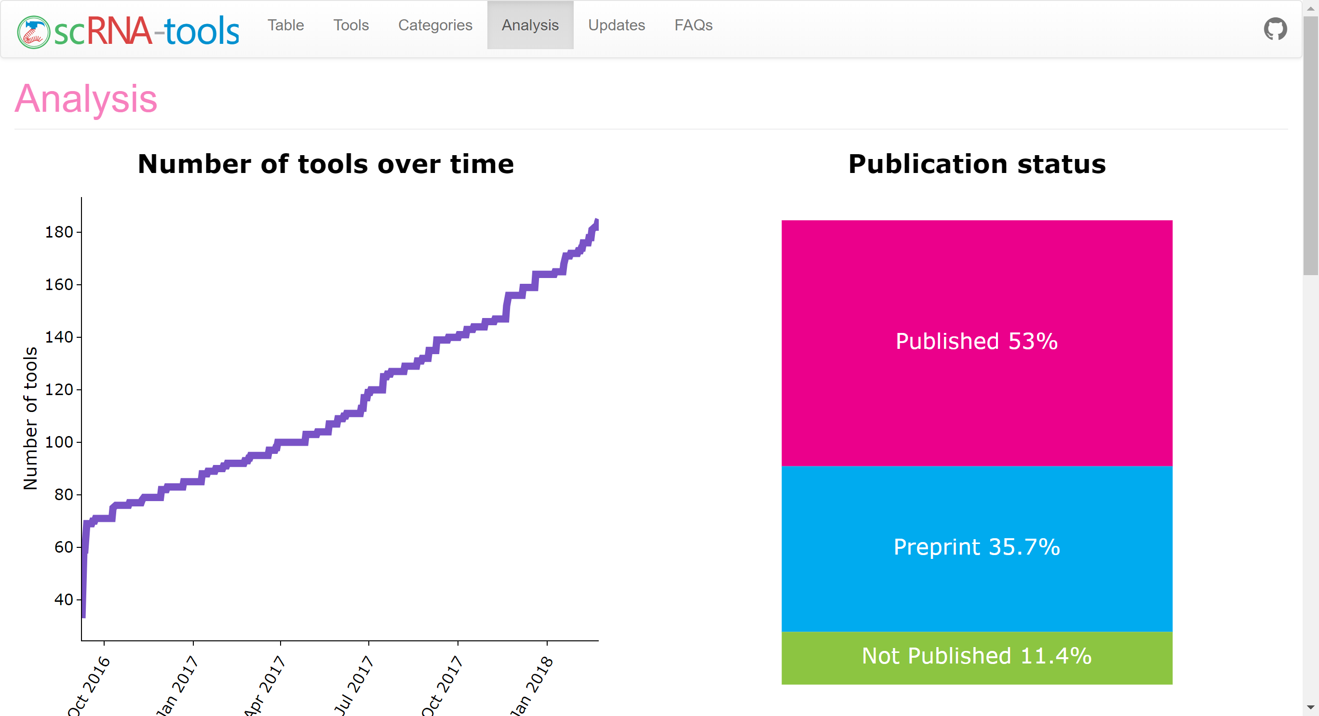

Slide 13
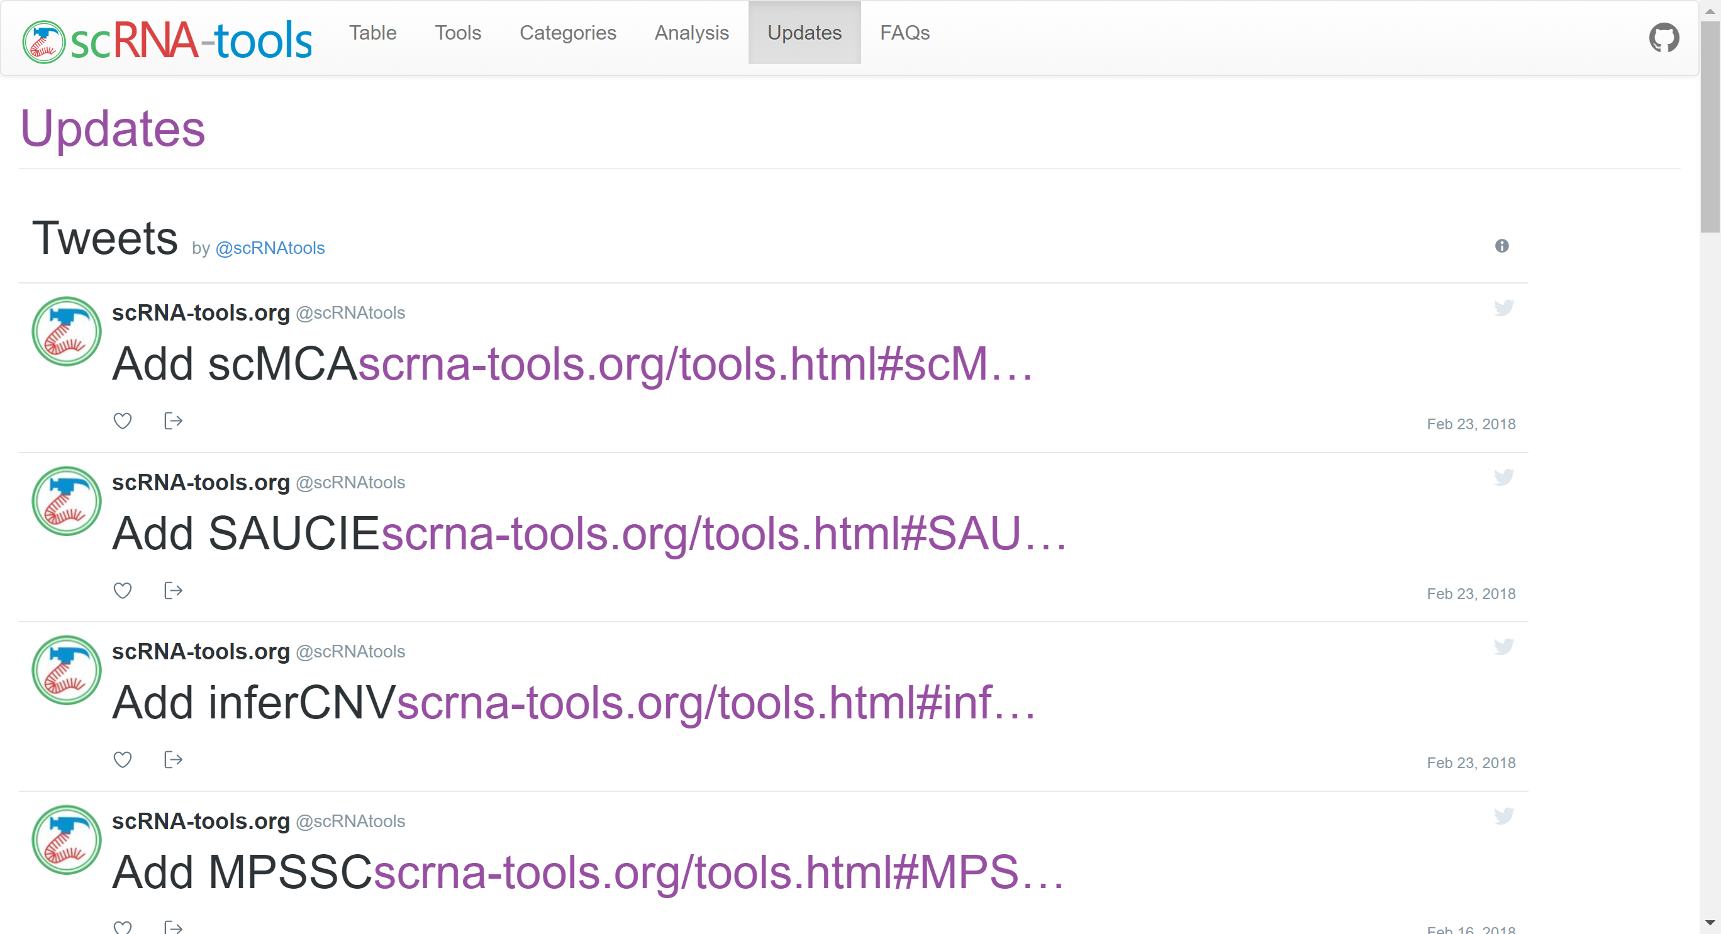

Slide 14
